Slide 1
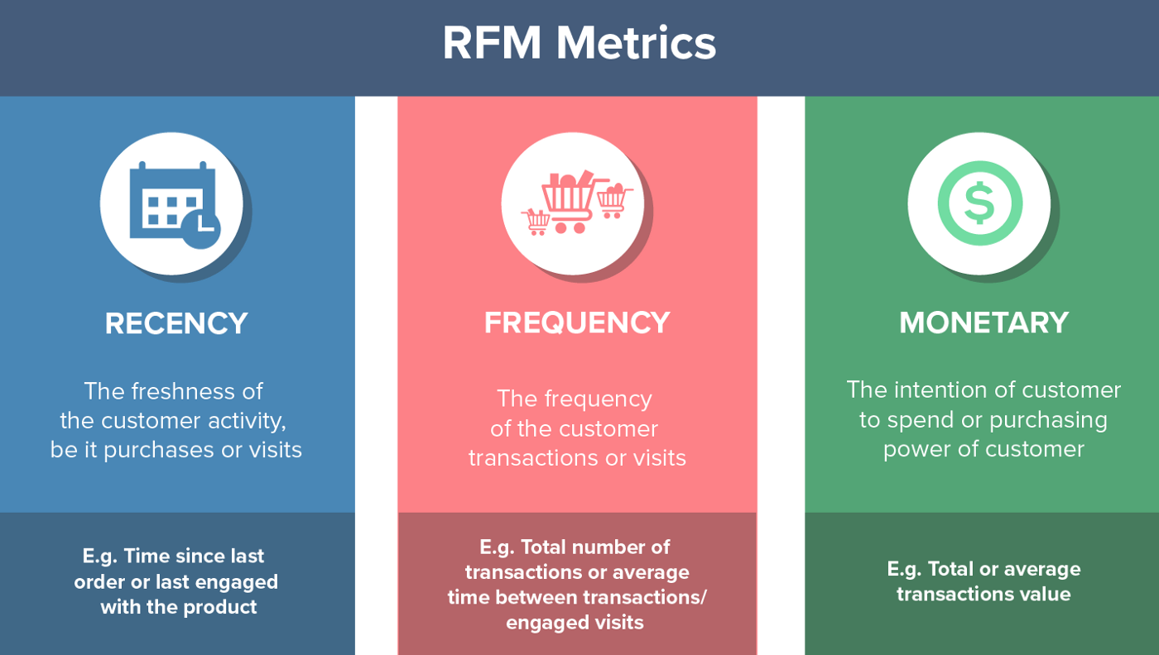

Slide 2
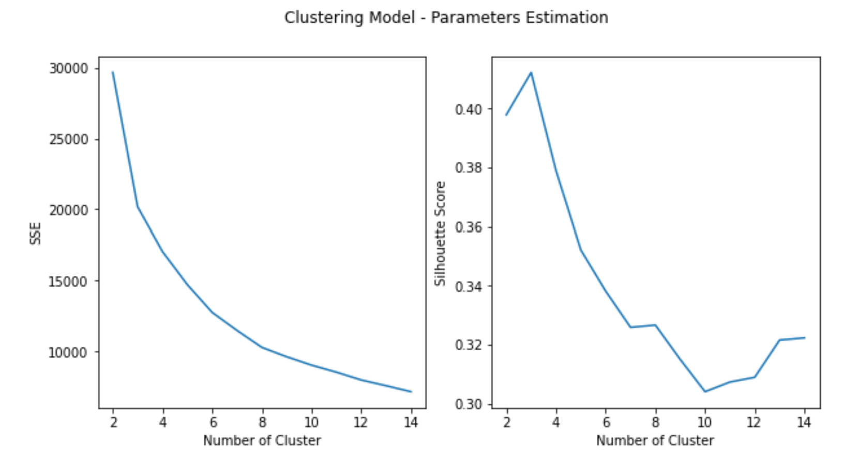

Slide 3
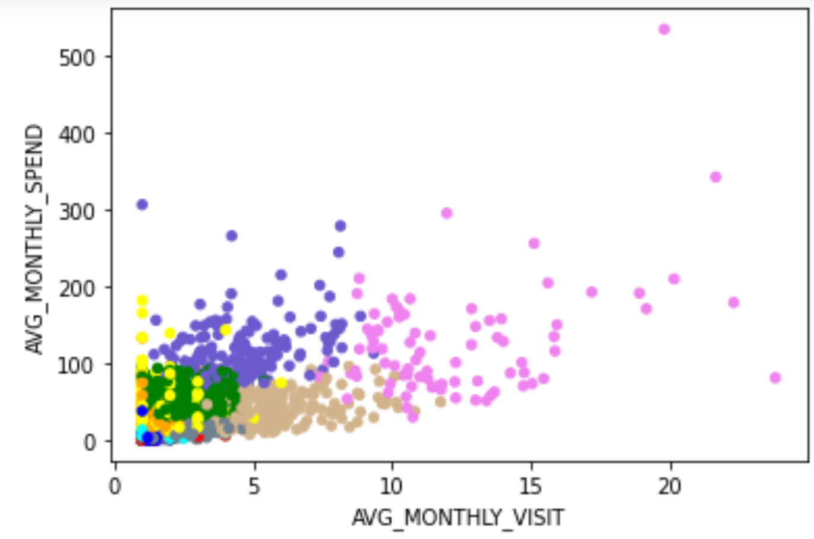
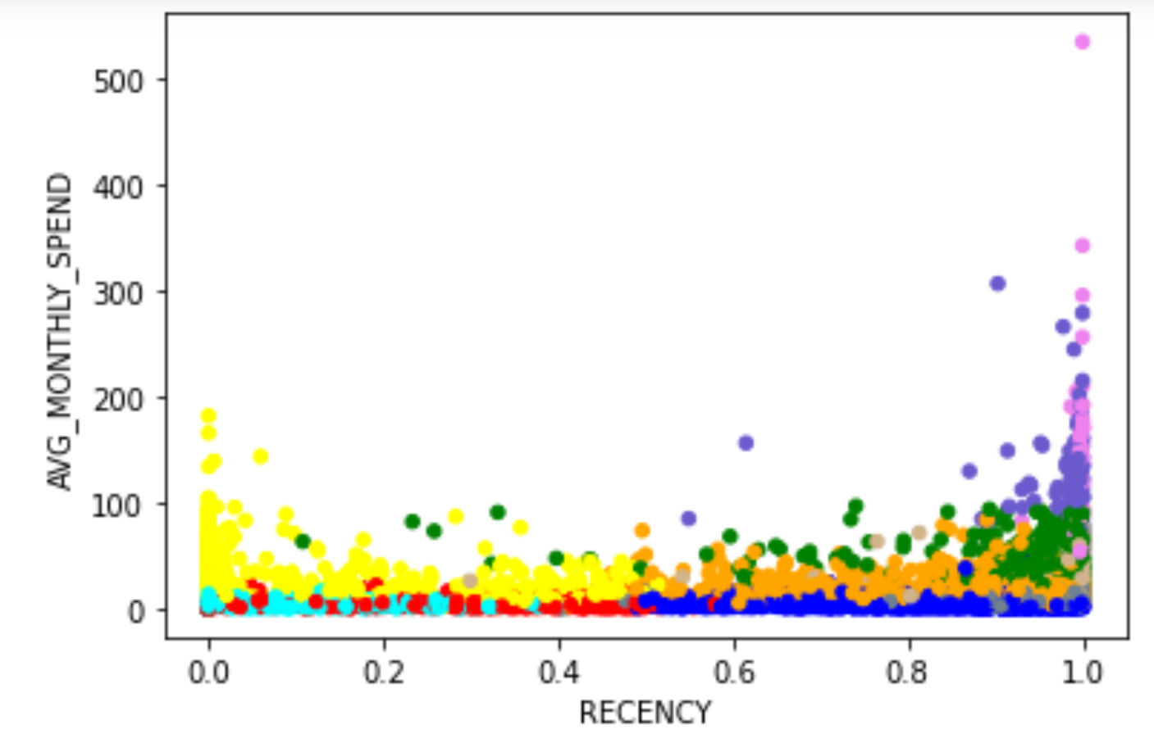
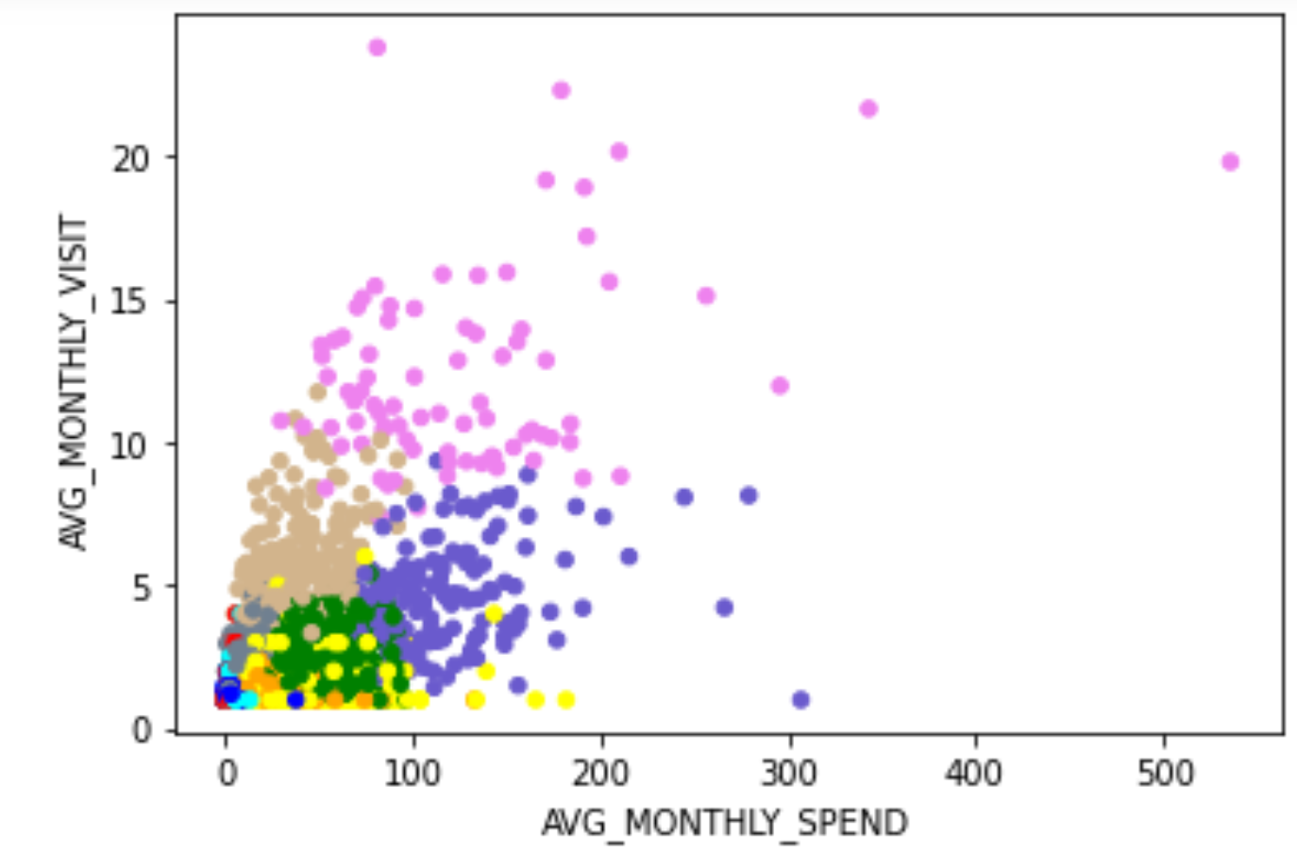
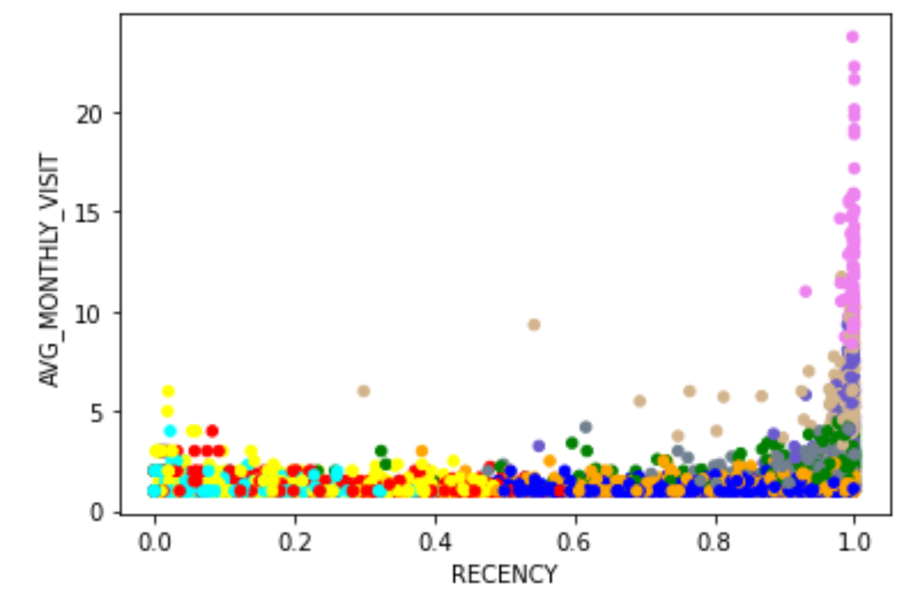
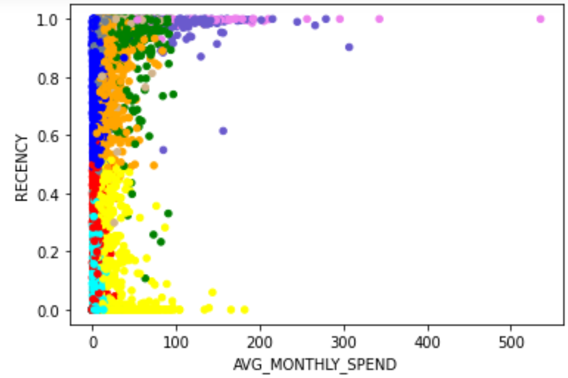
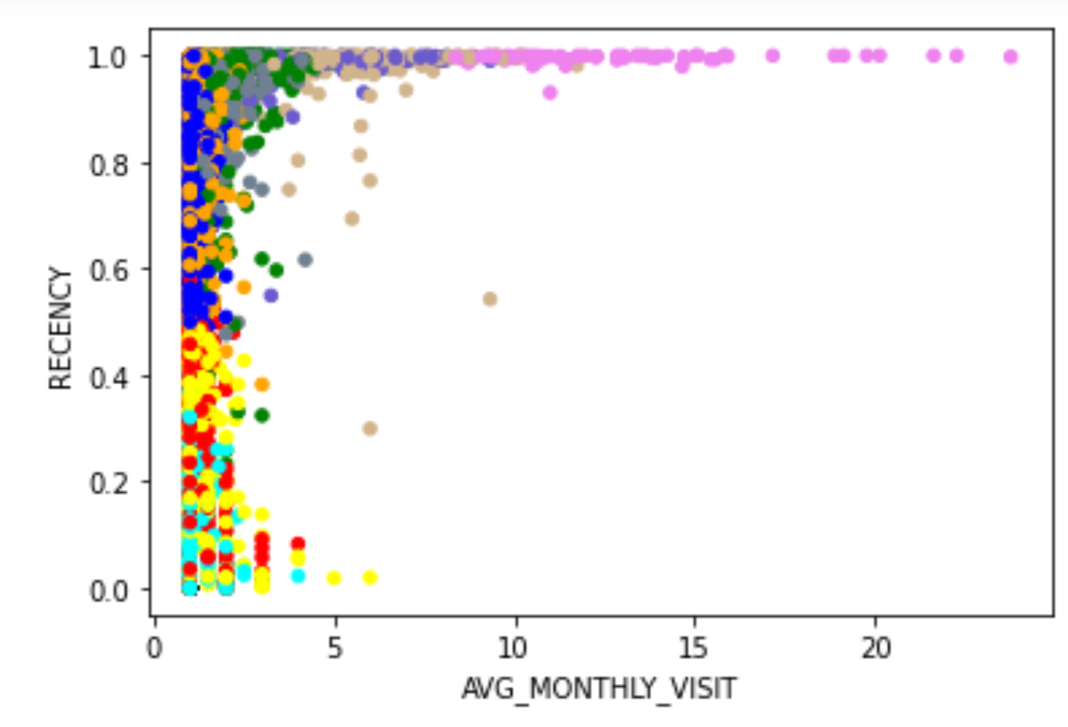
AVG MONTHLY SPEND
AVG MONTHLY VISIT
RECENCY
AVG MONTHLY SPEND
AVG MONTHLY VISIT
RECENCY

Slide 4
CUSTOMER SEGMENTATION
Characteristic | Possible Action
VVIP (Can’t Lose them) more spend, frequent visit and still active | Up selling and Cross selling. After services to maintain customer royalty.
NO TIME RICH GUY more spend, medium visit and still active | Introduce delivery application or online ordering.
HAVE TIME RICH GUY less spend, frequent visit and still active | Invite for activity such as promoting new product.
NORMAL GUY medium spend, less visit, and still active | General promotion.
NORMAL GUY Medium spend, less visit, and still active | General promotion.
BELOW AVG GUY less spend, less visit, and still active | Promotion : Nearly expire goods.
POOR GUY least spend, least visit, and still active | Promotion : Nearly expire goods.
CHURN Medium spend, less visit, not active | Require activate, investigate possible root cause of churn.
CHURN least spend, least visit, not active | Don’t waste time on them.
CHURN Least spend, least visit, not active | Don’t waste time on them.

